Slide 1
RESUME CLASSIFICATION

Slide 2

MEMBERS Subramani Prithivi Mrunal Kakade shrikrishna Jadhavar k Bhuvanesh Mohammed Thousif S. Sai Supriya Sharath Kumar

Slide 3
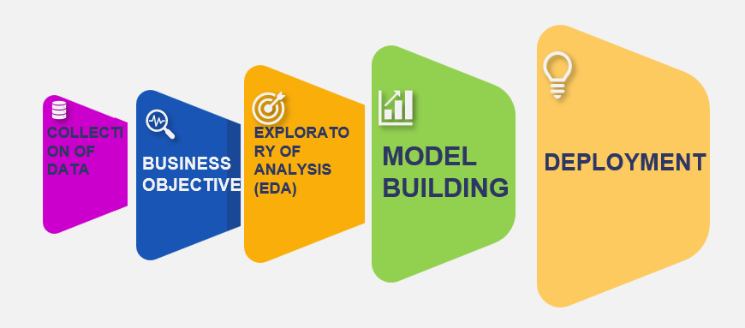
BUSINESS OBJECTIVE The Resume classification solution should significantly reduce the manual human effort in the HRM. It should achieve a higher level of accuracy and automation with minimal human intervention PROJECT ARCHITECTURE

Slide 4
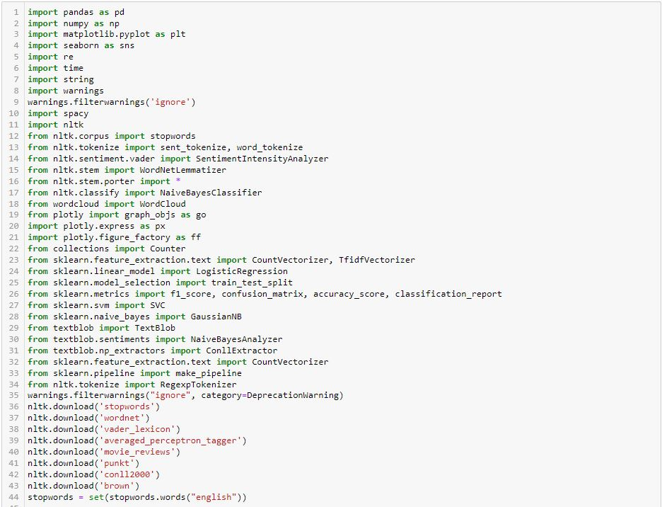

TEXTRACT
This packages provides a single interface for extracting content from any type of file, without any irrelevant markup.

Slide 5
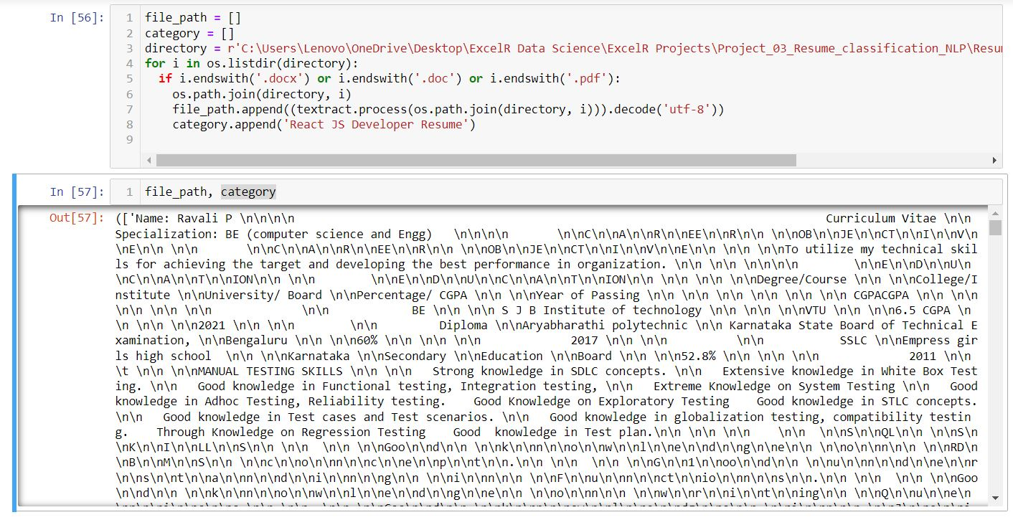
CONVERTING ALL FILES TO .TXT(PROCESS)

Slide 6
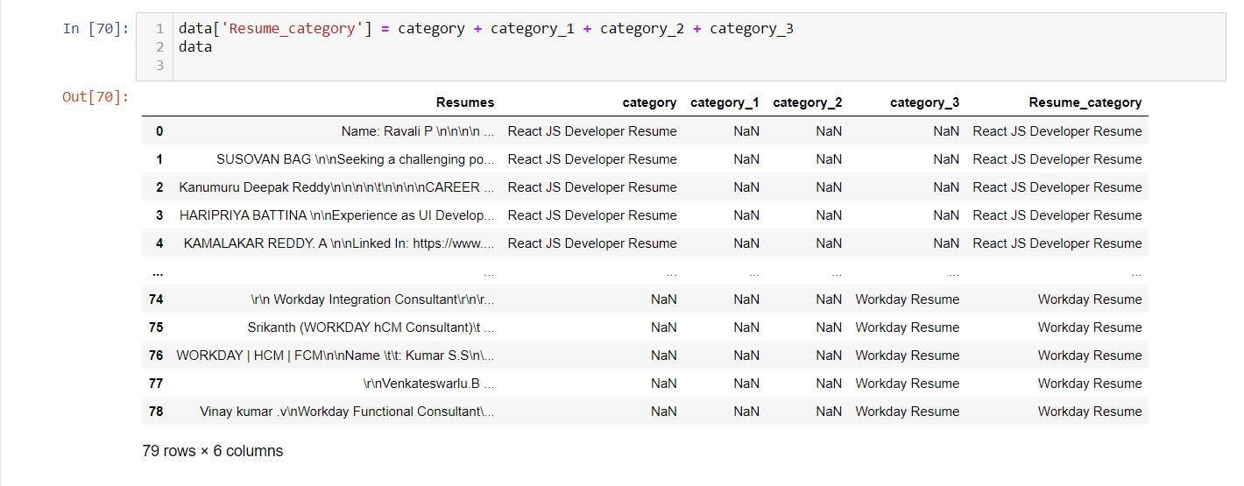
MERGING ALL CATEGORY FILES.

Slide 7
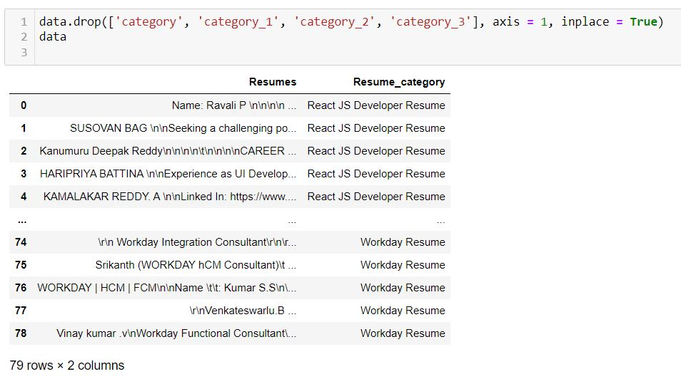

CONVERTING TEXT TO. CSV (PROCESS) After Extracting and Modifying the Dataset, the given data contains a total of 4 classes and 79 rows & 2 columns.

Slide 8
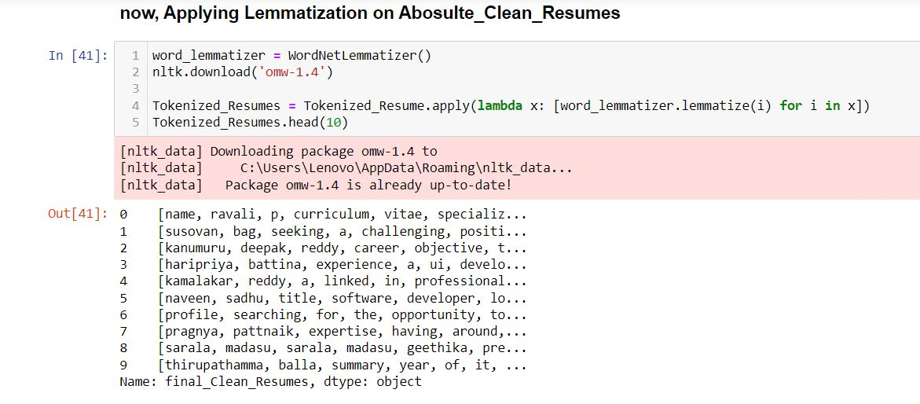
TEXT PREPROCESSING

Slide 9
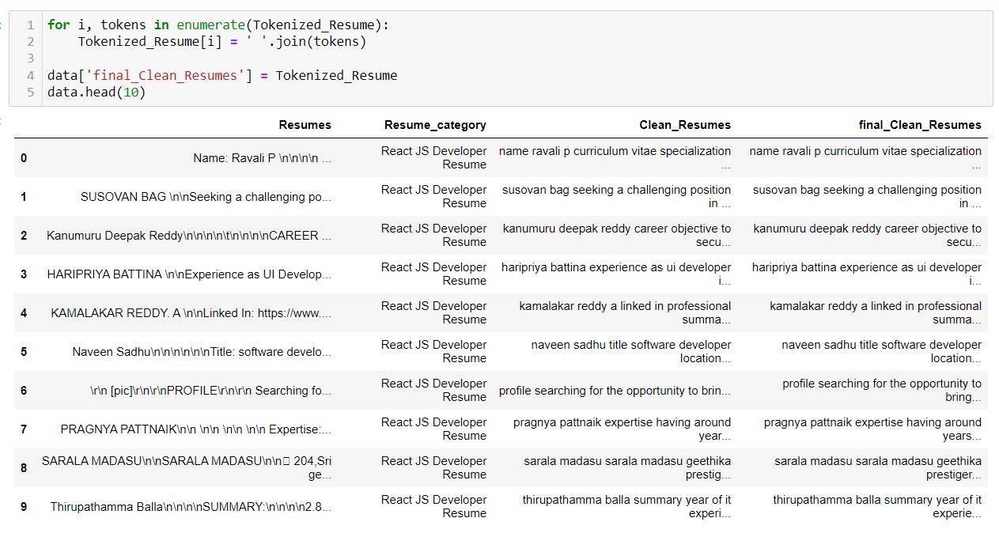

Slide 10
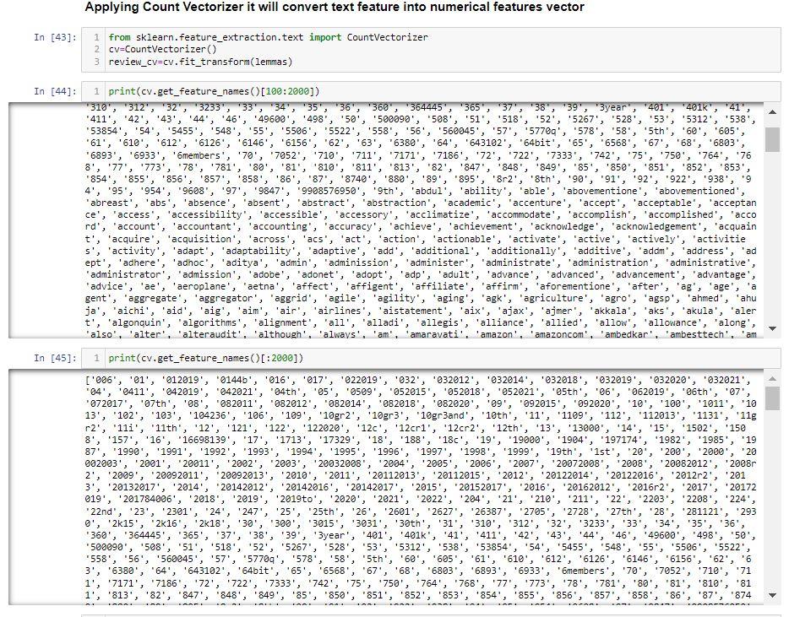

Slide 11
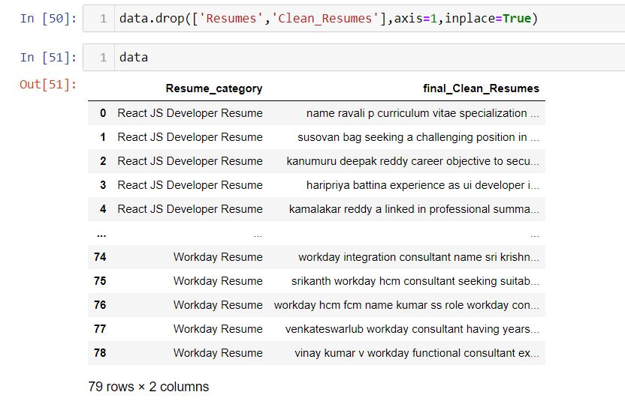
TEXT PREPROCESSING
In natural language processing, text preprocessing is the practice of cleaning and preparing text data. NLTK and re are common Python libraries used to handle many text preprocessing tasks.
The Dataset contains 79 rows and 2 Column.
There are total four Classes – Peoplesoft, Workday, React JS Developer and SQL Developer.

Slide 12
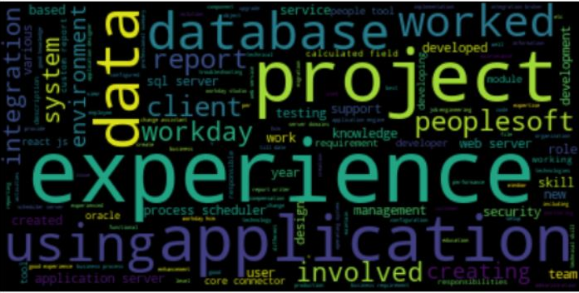
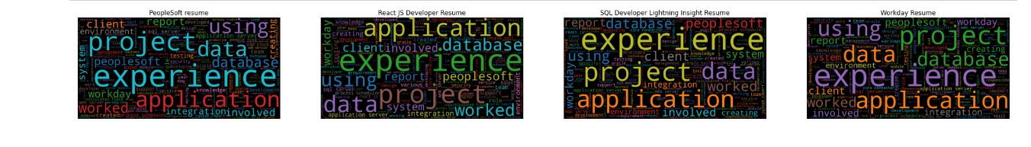
WORD CLOUD

Slide 13
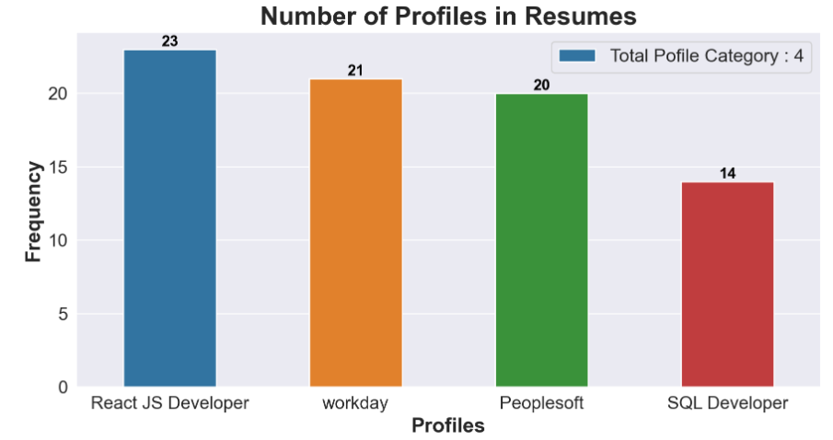
EDA Process cont..

Slide 14
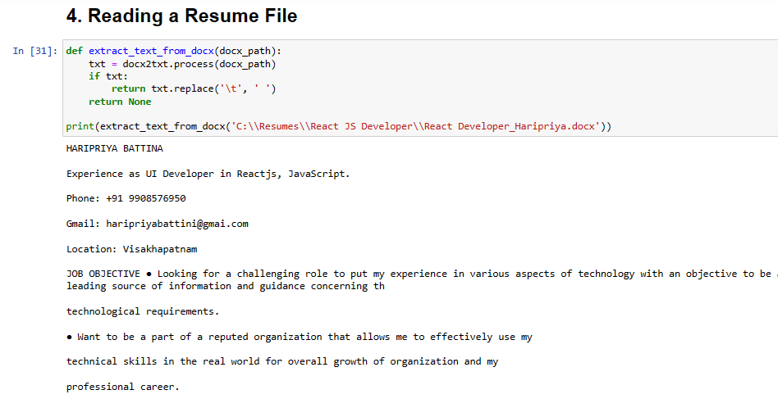
EDA Process cont..

Slide 15
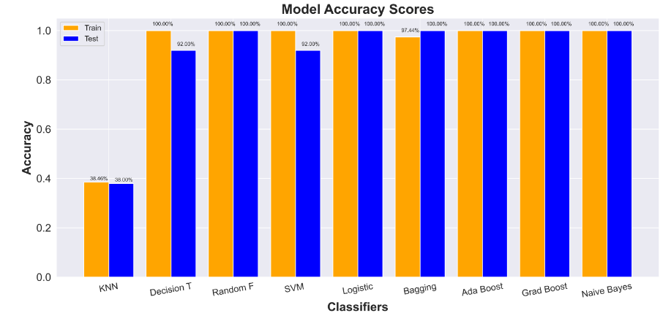
MODEL BUILDING

Slide 16
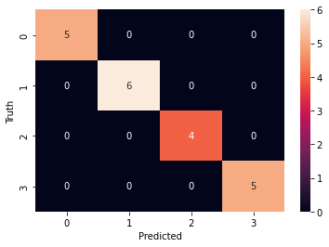
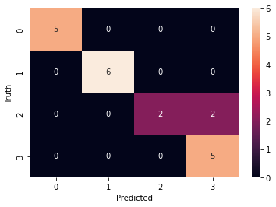
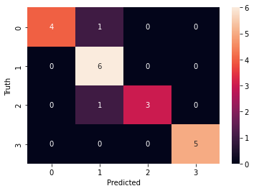
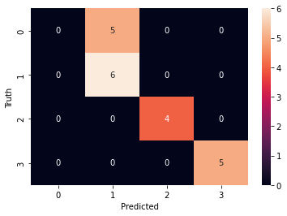
MODEL EVALUATION
Here, we have used model-building algorithms such as Decision Tree Classifiers, Ada boost classifiers, SVMs, and Random Forests.
Random forest
Naive bayes
SVM
100% accuracy was achieved using models like Random Forest, Decision Tree, and Gradient Boosting, with Light GBM being the final chosen model for its superior performance.
Decision Tree
Ada Boost
Gradient Boosting

Slide 17
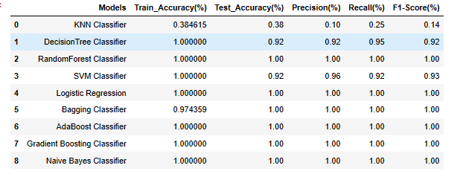
MODEL EVALUATION CONT..
Here, we have taken Model building algorithms such as Decision Tree Classifier, Ada boost classifier, SVM, Random , Forest, etc. finally we have taken DT for deployment.

Slide 18
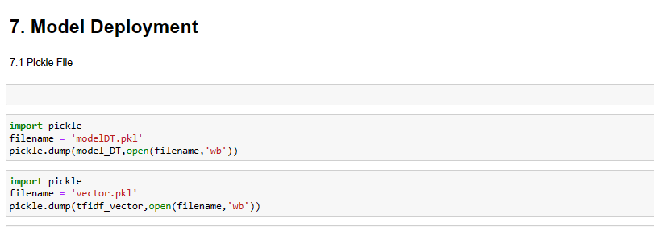
Model Deployment

Slide 19
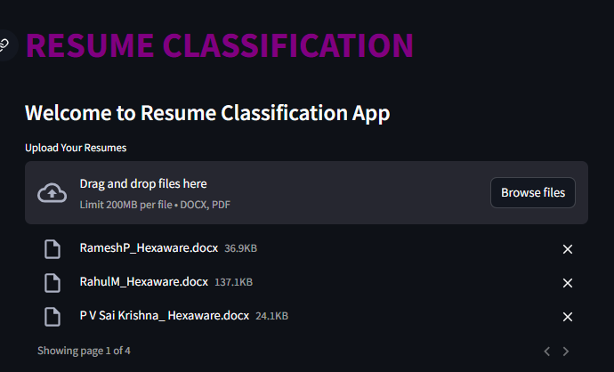
Model Deployment

Slide 20


